Slide 1
NLP based Chatbot for Restaurants
Project Team Members
P. Rheza Evangiline 20071A12A4
P. Sathvika 20071A12A7
M. Siddarth Reddy 20071A12B4
S. Shylesh Bhargava 20071A12B5
Under the Guidance of
P. Balakesava Reddy
Asst Professor
VNRVJIET

Slide 2
ABSTRACT
In today's fast-paced dining industry, customer satisfaction is paramount. Integrating cutting-edge technologies like Natural Language Processing (NLP) can significantly enhance the dining experience.
This project introduces a chatbot system designed to operate in a restaurant setting, facilitating interactions between customers and the establishment.
This system leverages NLP to engage with patrons, address their needs, and offer real-time support, ultimately improving customer service and streamlining restaurant operations.
We aimed to improve the chatbot's ability to generate responses by first getting pertinent facts from the database, after which it will produce a logical and suitable response for the given situation.

Slide 3
INTRODUCTION
NLP-driven chatbot ,focuses on continuously looking for methods to improve customer experience and optimize operations.
The chatbot's integration of transformer architectures and deep learning enables it to comprehend and react to a wide variety of customer queries, spanning from menu inquiry to reservation bookings.
The chatbot is smoothly linked with Streamlit, a Python-based toolkit for building interactive web apps, to maximize user accessibility and engagement.
Additionally, by answering common questions on its own, our NLP-powered chatbot not only improves the eating experience by giving prompt and accurate information, but it also increases the operational efficiency of restaurant workers.

Slide 4
LITERATURE SURVEY
Author | Paper | Methodology | Advantage | Disadvantage
Guendalina Caldarini,Sardar Jaf and Kenneth McGarry | A Literature Survey of Recent Advances in Chatbots(2022) | A long short term memory (LSTM) neural network was used. | This can handle multiple conversations simultaneously. | Less able to understand emotional linguistic cues , lack of human empathy.
Bhriguraj Borah, Dhrubajyoti Pathak, Priyankoo Sarmah | Survey of Textbased Chatbot in Perspective of Recent Technologies (2019) | RNN, LSTM, seq2seq model and NLG in context of intelligent response generation. | Ideal for businesses, reducing operational costs and simplifying complex processes. | Inconsistency in Natural Language Interpretation.
Sardar Jaf,Guendalina Caldarini | Use of Artificial Neural Network Chatbots(2022) | RNN,LSTM | Provides end-to-end solution that can be trained on different datasets, that is different domains. | Information must be encoded in a fixed length vector. Longer the sentence more information gets lost in process.

Slide 5
Author | Paper | Methodology | Advantage | Disadvantage
Guici Chen , Sijia Liu , Feng Jiang | IntelliBot: A Dialogue-based chatbot for the insurance industry (2018) | This is a deep recurrent neural network (DRNN)-based seq2seq model. | IntelliBot is superior in providing the user with a complete answer . | It cannot handle long coherent text It sometimes produces egregious responses.
Dires Negash Fente Dheeraj Kumar Singh | Weather Forecasting Using Artificial Neural Network (2021) | future weather con using LSTM the neural network is trained using different combinations of weather parameters | LSTM gives substantial results with high accuracy | Computational Complexity Interpretability
Gaurav J. Sawale, Dr. Sunil R. Gupta | A Smart Chatbot Architecture based NLP and Machine Learning for Health Care Assistance (2022) | Natural Language Generation(NLG), Automatic Speech Recognition(ASR). Components of NLP Engine-Intent Classifier, Entity Extractor. | Can offer details about medications like side effects and instructions for use. | This does not provide few medical features such as symptoms intensity, location and duration.

Slide 6
PROBLEM STATEMENT
Developing a natural language processing (NLP) based chatbot for restaurants that enhances customer experience, streamlines restaurant operations, and provides valuable information to users. The chatbot should be able to handle various user interactions and inquiries effectively.
This provides a clear overview of the goals and challenges associated with developing an NLP- based chatbot for restaurants. It serves as a foundation for the design, development, and deployment of the chatbot.

Slide 7
Functionalities of the Chatbot
Greet
Show menu
Show offers available
Show any vegan options if available
Explain more about any particular food item, giving details of its ingredients
Tell the hours the restaurant is open
Check and book a table if available and give the customer a unique booking ID
Suggest what to order
Give contact information of the restaurant
Give the address of the restaurant
Take positive and negative feedback, respond accordingly, and store it for the Restaurant management to check

Slide 8
DRAWBACKS OF THE EXISTING SYSTEM
The current NLP-based chatbot for restaurants uses an interactive platform to allow customers to book reservations, ask questions about menus, and get tailored recommendations.
However, there are certain drawbacks, such as the chatbot's inability to handle unexpected queries, which may negatively affect operational efficiency, and the chatbot's occasionally compromised accuracy in responses due to NLP complexities, longer response times caused by high computational requirements.

Slide 9
PROPOSED SYSTEM
The proposed chatbot system will leverage NLP to engage with restaurant patrons. It will handle tasks such as taking orders, answering menu inquiries, processing reservations, and even addressing specific dietary restrictions.
The advantages of this system include:
1. Enhanced Customer Experience: Customers will experience quick and personalized service, reducing wait times and improving overall satisfaction.

Slide 10
2. Efficiency: The chatbot can efficiently process orders and reservations, reducing errors and streamlining operations during peak hours.
3. Data Collection: The chatbot can collect valuable data on customer preferences and feedback, allowing the restaurant to make data-driven improvements.
4. Scalability: The system can seamlessly handle a high volume of customer interactions, ensuring consistent quality during busy periods.

Slide 11
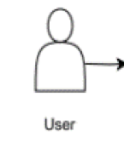
PROPOSED ARCHITECTURE
Frontend
Response
Query
feedback
Backend
update
NLP
(Model)
retrieval
Database
Feedback System

Slide 12
METHODOLOGY
In this project, we used an approach to improve user engagement and answer accuracy. To quickly retrieve and produce contextually relevant responses from a database, we integrated the Retriever-Augmented Generation (RAG) model, which combines retriever and generator components.
RAG combines the strengths of a retriever model, which finds relevant information, and a generator model, which crafts responses, to produce accurate and contextually relevant answers to user queries.
We used Streamlit, a Python-based web application framework, for the frontend interface, which gives users a simple way to communicate with the chatbot. We streamlined the intent recognition, answer creation, and text preprocessing operations on the backend by utilizing the Langchain framework.

Slide 13
This allowed for similarity matching for pertinent information retrieval. To ensure the chatbot's effectiveness and quickness in responding to user inquiries about menus, reservations, and recommendations, additional customer encounters and comments were added to the database on a regular basis.
Integrated transformers, which boost the chatbot's capacity to comprehend context, provide well-thought-out answers, and proficiently manage a range of customer inquiries.
Used the transformer structures in the implementation to process and produce natural language responses. Transformer models will be used by the chatbot to comprehend user inquiries and provide precise, contextually relevant answers. The chatbot will be enhanced with refined transformer models that were trained on an extensive dataset of customer reviews and restaurant-specific conversations.

Slide 14
Decoders for Transformers, transform the transformer's output into comprehensible, contextually relevant language to improve the chatbot's ability to generate responses.
Transformer decoders are incorporated into the chatbot's design to enable the system to provide responses that are more intelligent and sensitive to context. This guarantees that the chatbot can efficiently respond to a wide range of user inquiries and offer precise and insightful details regarding menus, bookings, and suggestions.

Slide 15
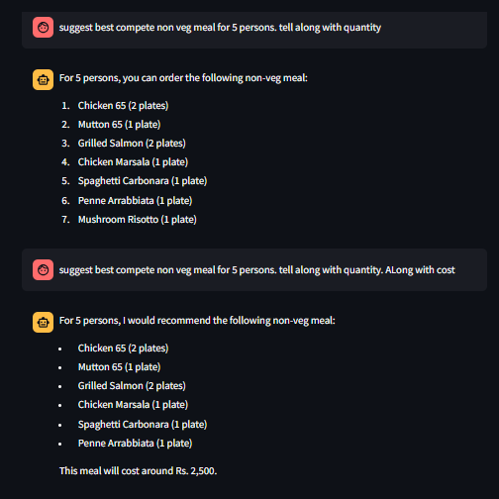
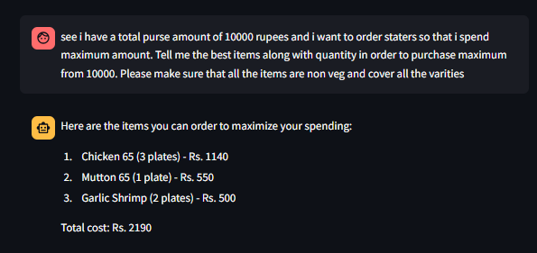
OUTPUT SCREENSHOTS

Slide 16
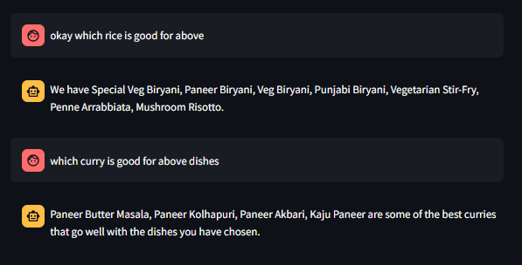
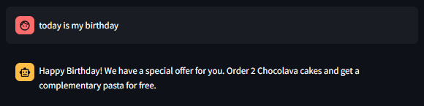

Slide 17
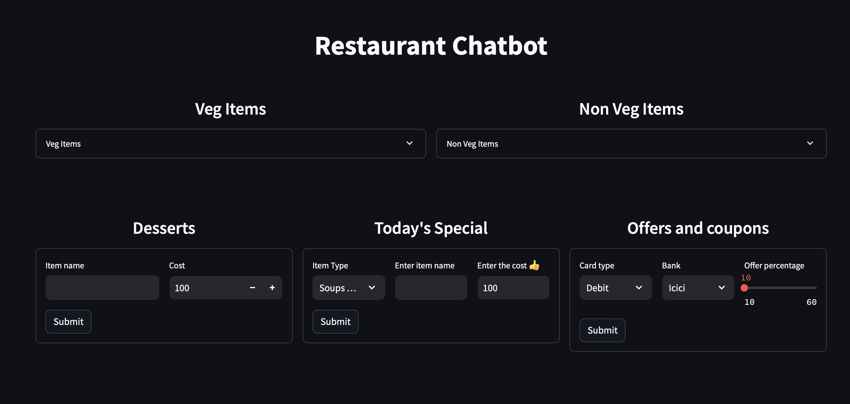

Slide 18
CONCLUSION
The development of an NLP-based chatbot for e-commerce customer support has been a significant undertaking, but the outcomes achieved demonstrate its potential to revolutionize customer service in the digital age. Through robust natural language understanding (NLU) models, personalized responses, effective dialogue management, seamless integration, and continuous improvement mechanisms, the chatbot has addressed key challenges in enhancing efficiency and customer satisfaction.
Essentially, this chatbot architecture offers a viable route for restaurants to transform their operations and customer interactions while also pushing the limits of chatbot capabilities. This presents significant prospects for advancement and growth in the field of conversational AI agents.

Slide 19
REFERENCES
Jurafsky, D., & Martin, J. H. (2020). "Speech and Language Processing" (3rd edition). Pearson.
This textbook provides comprehensive coverage of natural language processing techniques, including those used in chatbot development.
Rasa Documentation:
The official documentation of the Rasa framework offers detailed guidance on building chatbots using open-source tools. (https://rasa.com/docs/)
Hugging Face Transformers:
The Hugging Face Transformers library provides pre-trained models for various NLP tasks, including chatbot development. Their documentation and tutorials can be a valuable resource. (https://huggingface.co/transformers/)

Slide 20
4. GPT-3 OpenAI API Documentation:
OpenAI's documentation for the GPT-3 API provides insights into using pre-trained language models like GPT-3 for chatbot development. (https://beta.openai.com/docs/)
5. SpaCy Documentation:
The official documentation for the spaCy NLP framework is a great resource for understanding text processing and entity recognition. (https://spacy.io/usage)
6. NLTK (Natural Language Toolkit) Documentation:
NLTK is a popular Python library for working with human language data. Its documentation covers a wide range of NLP techniques and tools. (https://www.nltk.org/)

Slide 21
THANK YOU

